Slide 1
Factorizable Graph Convolutional Networks
2020_NeurIPS
Code:github.com/ihollywhy/FactorGCN.PyTorch
2021.02.02 • ChongQing
Reported by Chenghong Li

Slide 2
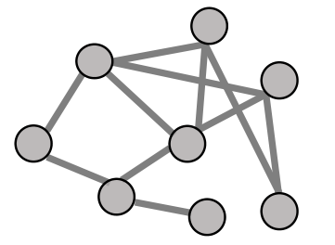
Introduction
The relations between the entities connected in the graph are in many cases heterogeneous, but entangled together and denoted merely as a single edge between a pair of nodes.
In many real-world graphs, multiple heterogeneous relations between nodes are mixed and collapsed to one single edge.

Slide 3
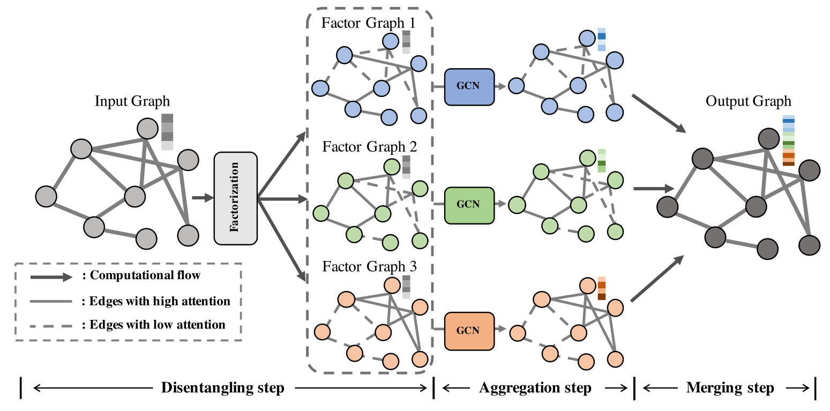
Method

Slide 4
Experiments

Slide 5
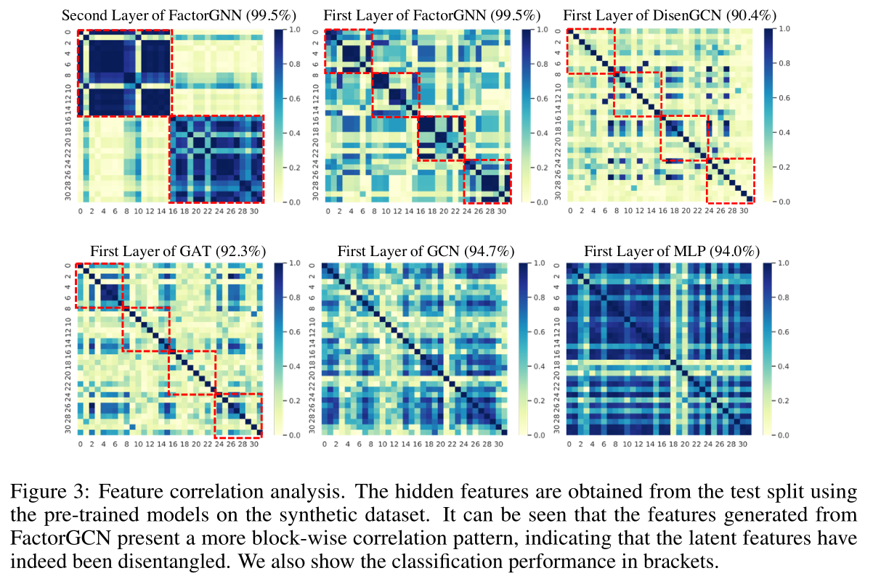
Experiments

Slide 6
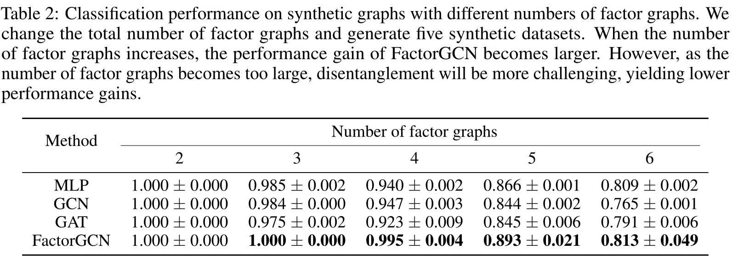
Experiments

Slide 7
Experiments

Slide 8
Experiments

